Slide 1
GARMENTS INVENTORY MANAGEMENT SYSTEM

Slide 2
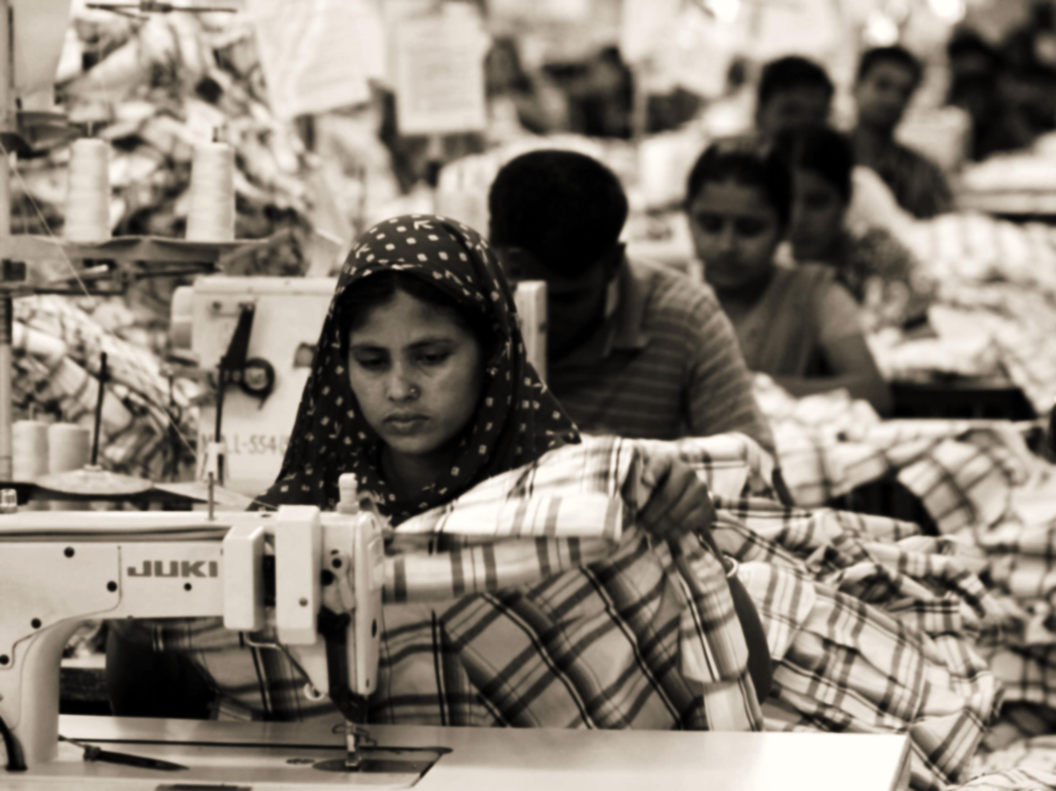
The Endless Possibility Economy of Bangladesh is largely dependent on the garments sector. It has attracted worldwide attention.
3.6 million active workers.*
78% of total export earn.*
More enormous investment to come.

Slide 3
SUBSYSTEMS
Raw material storage
Raw material forwarding
Production stage tracking
Delivery subsystem

Slide 4
RAW MATERIAL STORAGE
SUBSYSTEM 1

Slide 5
Raw material storage Actor’s Glossary
ACTOR | SHORT KEY | ACTIVITY SCOPE
Main office | MO | Places a demand for raw material, gives confirmation on receiving materials
Storage manager | SM | Checks and updates the storage balance
Storage worker | SW | Inputs the products in storage
Production manager | PM | Starts production on receiving materials

Slide 6
Raw material storage Use Case Glossary
Use case name | Use case id | Description | Participant actors and roles
Get user demand | 1.1 | filling up a demand form depending on the nature of the contract | MO fills the form, SM receives it.
Match type | 1.2 | After receiving the demands, the type of the products is matched | SW matches the requirements
Match quantity | 1.3 | After receiving the demands ,the quantity is matched | Same as type matching
Confirm order | 1.4 | After matching the order is confirmed | SM confirms the order, sends the goods to the factory, PM receives it, starts production, MO receives confirmation
Update storage balance | 1.5 | After sending an order, the balance of storage is updated | SW updates the balance, SM oversees it for transparency.
Check storage balance | 1.6 | checking the current balance of the inventory at any time. | MO checks the balance, system provides output.

Slide 7
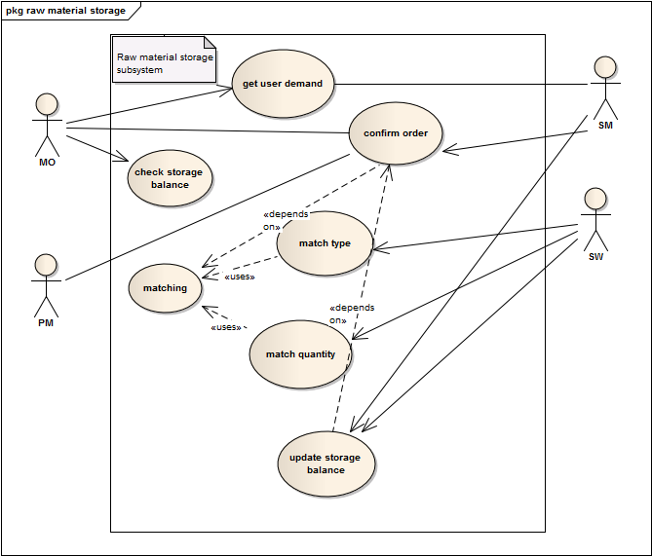
Raw material storage Use Case Diagram

Slide 8
Raw material storage
1.1 Get User Demand
Use case name: | Get user demand
Use case id | 1.1
Priority | High
Primary system actor | Main office(MO)
External receiver actor | Storage manager(SM)
Description | filling up a demand form depending on the nature of the contract
Trigger by | MO

Slide 9
Raw material storage
1.1 Get User Demand
Course of Events : Typical
Actor action | System response
Step 1: fill up a demand form and submit it online | Step 2: forward the form to the storage manager
 | Step 3: make an entry

Slide 10
Raw material storage
1.2 Match Type
Use case name: | Match type
Use case id | 1.2
Priority | High
Primary business actor | Storage worker(SW)
Description | Matching the type of products in the inventory according to the order form
Trigger by | SW
Actor action | System response
Step1: SW requests the demand form | Step 2: show the submitted demand form
Step 3: SW matches the type of material demanded to the type of material stored. | Step 4: make an entry(whether match found or not found) in the system.

Slide 11
Raw material storage
1.2 Match Type
Course of Events : Typical and Alternate
Actor action | System response
Step1: SW requests the demand form | Step 2: show the submitted demand form
Step 3: SW matches the type of material demanded to the type of material stored. | Step 4: make an entry(whether match found or not found) in the system.
Actor action | System response
 | Step 4: make an entry of match not found in the system.
Step 5:notify main office
Step 6: main office buys necessary materials.

Slide 12
Raw material storage
1.3 Match Quantity
Use case name: | match quantity
Use case id | 1.3
Priority | High
Primary system actor | Storage worker(SW)
Description | Matching the quantity of products in the inventory according to the order form
Trigger by | SW

Slide 13
Raw material storage
1.3 Match Quantity
Course of Events : Typical and Alternate
Actor action | System response
Step1: SW requests the demand form | Step 2: show the submitted demand form
Step 3: SW matches the quantity of material demanded to the Quantity of material stored. | Step 4: make an entry(whether match found or not found) in the system.
Actor action | System response
 | Step 4: make an entry of match not found in the system.
Step 5:notify main office
Step 6: main office buys necessary materials.

Slide 14
Raw material storage
1.4 Confirm Order
Use case name: | Confirm order
Use case id | 1.4
Priority | High
Primary system actor | Storage manager(SM)
Other participating actors | Main office(external receiver actor),production manager(external server actor)
Description | Confirming the order, notifying the production manager and main office
Trigger by | SM

Slide 15
Raw material storage
1.4 Confirm Order
Course of Events : Typical
Actor action | System response
 | Step 1: system notifys the SM of finding a match with the order form
Step 2: SM rechecks the order form and storage materials(optional)
Step 3:SM requests to send a confirmation to MO and PM | Step 4: system notifies MO and PM of order confirmation

Slide 16
Raw material storage
1.5 Update Storage Balance
Use case name: | Update storage balance
Use case id | 1.5
Priority | High
Primary system actor | Storage worker(SW)
Other participating actor | Storage manager(SM)
Description | Updating the inventory balance of storage after confirming an order
Trigger by | SM

Slide 17
Raw material storage
1.5 Update Storage Balance
Course of Events : Typical
Actor action | System response
Step 1: SW requests to change the storage balance | Step 2: system provides a form for changing balance
Step 2: SW inputs the amount of material sent | Step 3:system subtracts the amount of material sent from inventory.
 | Step 4:system shows the change made to SW
 | Step 5:system notifies the SM of changes made
Step 6: SM aproves of the changes | Step 7:system saves the changes.

Slide 18
Raw material storage
1.6 Check Storage Balance
Use case name: | Check storage balance
Use case id | 1.6
Priority | High
Primary business actor | MO
Description | checking the inventory balance
Trigger by | MO

Slide 19
Raw material storage
1.6 Check Storage Balance
Course of Events : Typical
Actor action | System response
Step 1: MO requests to check the storage balance | Step 2: system provides detail of current balance

Slide 20
PRODUCTION STAGE TRACKING
SUBSYSTEM 3

Slide 21
Production Stage Tracking Actor’s Glossary
Actor name | Short key | Activity scope
Production manager | PM | updates the status of production, sends confirmation to MO, forwards the products to DM.
Section supervisor | SS | updates the status of production in his section, checks for defected products, sends report to PM
production workers | PW | inputs the finished and defected production status

Slide 22
Production Stage Tracking Use Case Glossary
Use case name | Use case id | Description | Participant actors and roles
view cutting status | 3.1 | Checking and updating cutting section product status | cutting section SS updates , PM checks it
view sewing status | 3.2 | Checking and updating sewing section product status | sewing section SS updates , PM checks it
view packing status | 3.3 | Checking and updating packing section product status | packing section SS updates , PM checks it
view defection status | 3.4 | Checking and updating defected product status | CSS,SSS,PSS inputs, PM checks
Update production completion status | 3.5 | Updating total production status of the order | PM updates

Slide 23
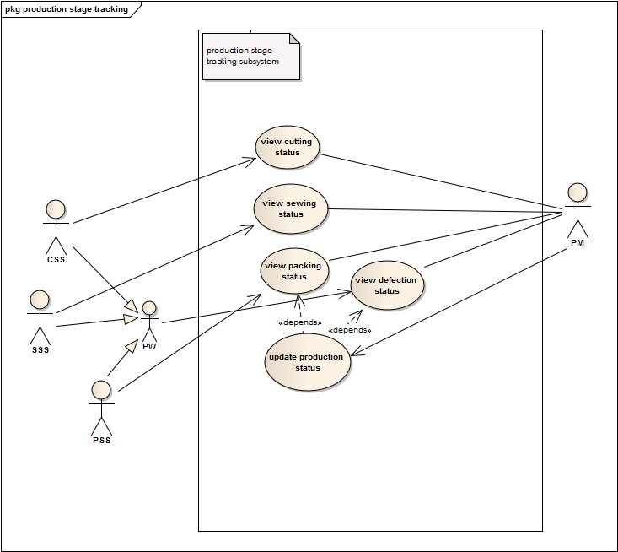
Production Stage Tracking Use Case Diagram

Slide 24
Production Stage Tracking
3.1 View Cutting Status
Use case name: | View cutting status
Use case id | 3.1
Priority | Normal
Primary system actor | Cutting Section Supervisor(CSS)
External receiver actor | Production manager(PM)
Description | Checking and updating cutting section product status
Trigger by | CSS

Slide 25
Production Stage Tracking
3.1 View Cutting Status
Course of Events : Typical and Alternate
Actor action | System response
Step 1: CSS requests to input report | Step 2: show an UI to update
Step 3: CSS inputs a status report | Step 4: delete previous report and store the new input
Step 5: PM checks for status | Step 6: show stored status
Actor action | System response
Step 5: report a problem | Step 6: sends notification to production manager

Slide 26
Production Stage Tracking
3.2 View Sewing Status
Use case name: | View sewing status
Use case id | 3.2
Priority | Normal
Primary system actor | Sewing Section Supervisor(SSS)
External receiver actor | Production manager(PM)
Description | Checking and updating sewing section product status
Trigger by | SSS

Slide 27
Production Stage Tracking
3.2 View sewing Status
Course of Events : Typical and Alternate
Actor action | System response
Step 1: SSS requests to input report | Step 2: show an UI to update
Step 3: SSS inputs a status report | Step 4: delete previous report and store the new input
Step 5: PM check for status | Step 6: show stored status
Actor action | System response
Step 5: SSS report a problem | Step 6: sends notification to production manager

Slide 28
Production Stage Tracking
3.3 View Packing Status
Use case name: | View packing status
Use case id | 3.3
Priority | Normal
Primary system actor | packing Section Supervisor(PSS)
External receiver actor | Production manager(PM)
Description | Checking and updating packing section product status
Trigger by | PSS

Slide 29
Production Stage Tracking
3.3 View Packing Status
Course of Events : Typical and Alternate
Actor action | System response
Step 1: PSS requests to input report | Step 2: show an UI to update
Step 3: PSS inputs a status report | Step 4: delete previous report and store the new input
Step 5: PM check for status | Step 6: show stored status
Actor action | System response
Step 5: PSS report a problem | Step 6: sends notification to production manager

Slide 30
Production Stage Tracking
3.4 View Defection Status
Use case name: | View defection status
Use case id | 3.4
Priority | Low
Primary system actor | CSS, SSS, PSS
External receiver actor | Production manager(PM)
Description | Checking and updating defected product status
Trigger by | CSS,SSS or PSS

Slide 31
Production Stage Tracking
3.4 View Defection Status
Course of Events : Typical
Actor action | System response
Step 1:PSS/CSS/SSS requests to input a defection status | Step 2: show a form for entering defection status
Step 3: PSS/CSS/SSS inputs a defection status | Step 4: increase defection count by one and store into defection report center
Step 5: PM check defection status | Step 6: show defection percentage and defection report

Slide 32
Production Stage Tracking
3.5 Update Production Completion Status
Use case name: | User demand
Use case id | 3.5
Priority | High
Primary system actor | Production manager(PM)
External receiver actor | Main Office (MO)
Description | Updating total production status of the order
Trigger by | PM

Slide 33
Production Stage Tracking
3.5 Update Product Completion Status
Course of Events : Typical and Alternate
Actor action | System response
Step 1: PM requests to update status | Step 2: show update UI
Step 3: PM updates status | Step 4: store status
Step 5: MO check for status | Step 6: show stored status
 | Step 7: sends notification to Main Office

Slide 34
THANK YOU!

Slide 35
RAW MATERIAL FORWARDING
SUBSYSTEM 2

Slide 36
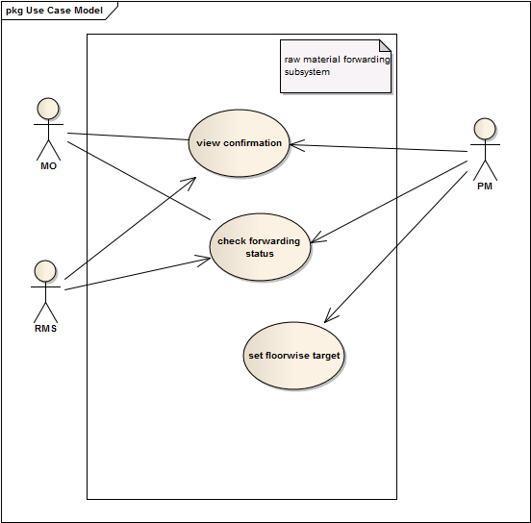
Raw material Forwarding Use Case Diagram

Slide 37
DELIVERY OF PRODUCTS
SUBSYSTEM 4

Slide 38
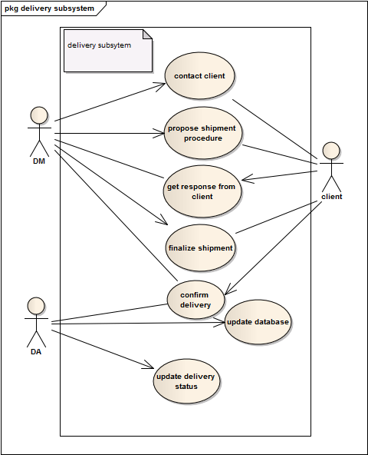
Delivery Of Products Use Case Diagram

